Slide 1
WORKING IN (or out of) OUR PRIMARY COVERAGE AREA
Ken Pink
NOA
11/4/26

Slide 2
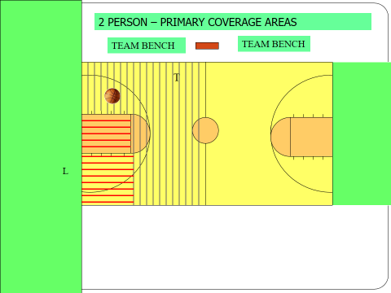

Slide 3
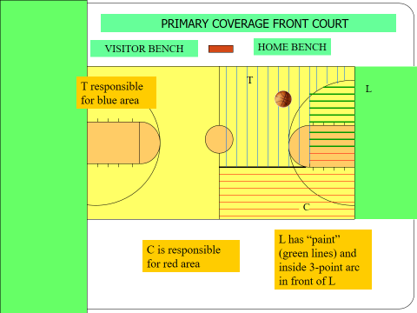

Slide 4
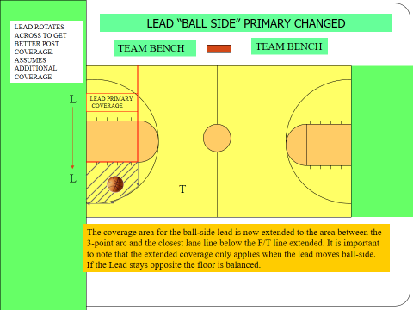

Slide 5
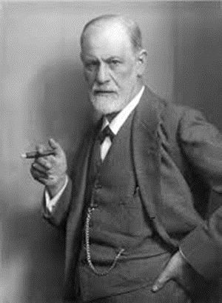
THE PSYCHOLOGY OF OFFICIATING OUR PRIMARY COVERAGE AREA
Sigmund Freud

Slide 6
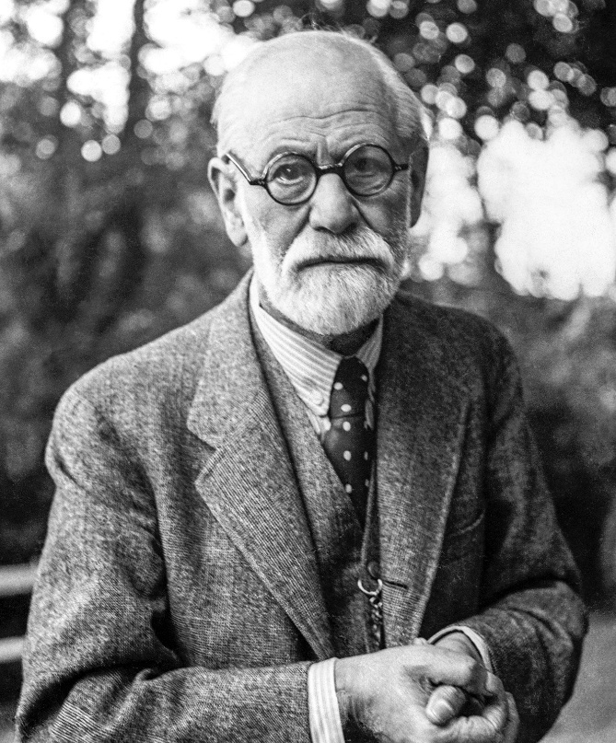
THE PSYCHOLOGY OF OFFICIATING
“I, Sigmund Freud, ask you to stop thinking like an official for a few minutes—and start thinking about why you behave like one. For the length of this presentation, do not ask yourself, ‘What did I see?’ Ask yourself, ‘Why did I feel compelled to blow the whistle?’ You believe you blow the whistle because you saw something. But seeing is only the beginning. Something within you may have already decided that you must act. The interesting question is not merely what happened on the floor, but what happened inside you before your whistle sounded. So, for the length of this presentation, let's stop asking whether the play was a foul. Let's ask a more uncomfortable question: ‘Why did I feel the need to make that call when it wasn't my call to make?’
Sigmund Freud

Slide 7
What does it take to cover our Primary Coverage Area?
according to Freud
Each crew member acting responsibly
Discipline, trust, teamwork
Sharp judgment, slow whistles

Slide 8


What our Primary Coverage Area is not
according to Freud
Mindset of viewing entire court
Belief we are helping our partners.
Where I happen to be looking at the moment.

Slide 9
Why officials reach outside their PCA
according to Freud
Big, loud, obvious contact
Natural reaction to motion and impact
Fear of nobody calling it
Whistle impulse happens before PCA check
Misguided attempt to showcase officiating strength.

Slide 10
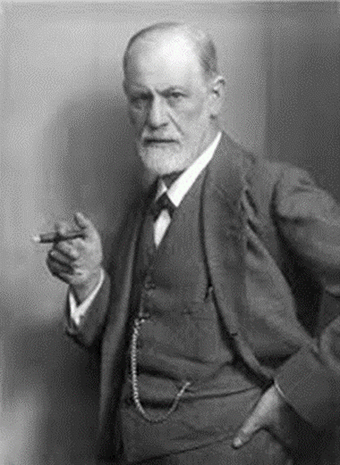
And furthermore– regarding officials reaching out of their PCA according to Freud
2 person mechanics
3 person mechanics
Veteran officials are more susceptible because they read plays faster and anticipate contact earlier.
Nervous, anxious, or apprehensive officials
Some officials still learning coverage areas
A large amount of space to cover for two officials

Slide 11
When officials reach outside their PCA
according to Freud
Wandering eyes lead to increased whistles
Missed fouls and violations inside your PCA due to wandering eyes
Coaches reacting to what we didn’t see, not what we called
Coaches lose confidence in crew’s court coverage
Every whistle becomes more magnified
Reputations suffer. Perceptions are formed

Slide 12
When the crew focuses on their PCA
according to Freud
Court coverage greatly improves
Double whistles will decrease
Game management is under control
All crew members give the appearance of working in sync

Slide 13
What are our PCA goals and objectives?
according to Freud
Choose discipline over instinct. Resist the urge to intervene
The absence of action does not mean the absence of responsibility
The goal isn’t to eliminate the impulse. The goal is to control it
One official can’t officiate ten players. We shouldn’t try to. Remember where your focus belongs. Officiate the players, and the game action in your primary
Our goals should be the right mindset, and better self-control.
Not an error free game

Slide 14
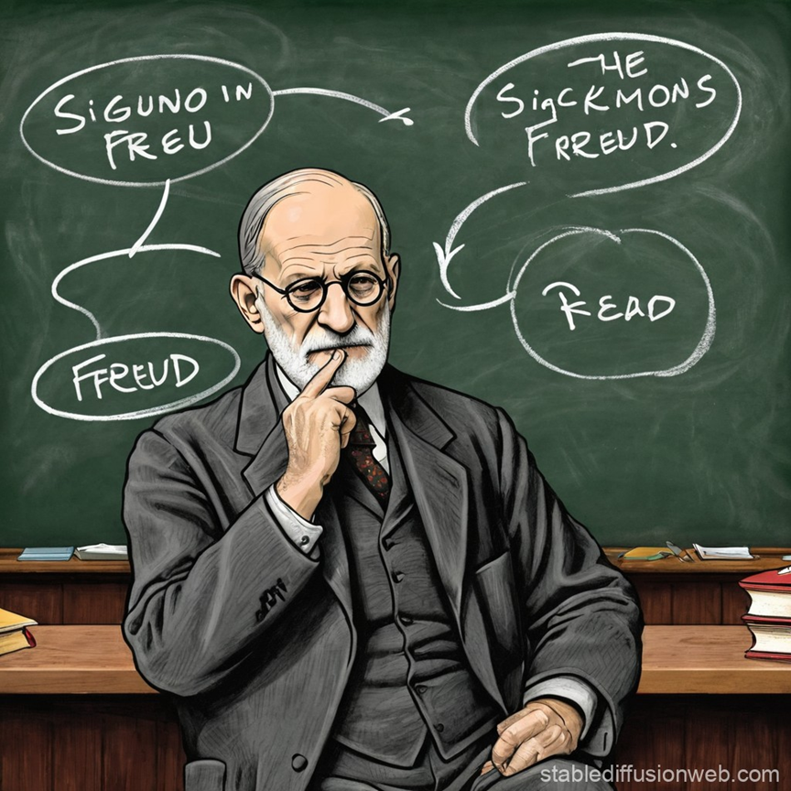
QUESTIONS?
COMMENTS?

Slide 15
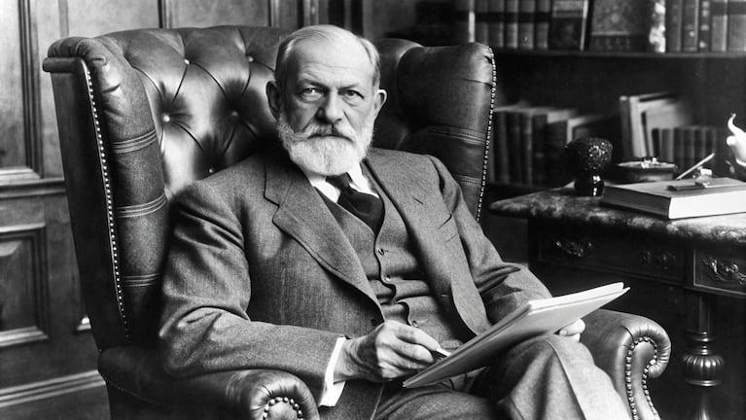
“ The player who abandons his appointed territory is often not pursuing the ball, but his own unconscious desire to become the hero.
The ego whispers, ‘Trust the system.’ The id cries, ‘Steal the play.’
The most successful officials are those whose ego prevails.”

Slide 16
Thank You

